Slide 1



UNIVERSITY INSTITUTE OF ENGINEERING
COMPUTER SCIENCE ENGINEERING
Bachelor of Engineering
Design and Analysis of Algorithms(CST-311/ITT-311)
Topic: Trees
DISCOVER . LEARN . EMPOWER

Slide 2
Learning Objectives & Outcomes
Objective:
To understand the meaning of Tree
To Study its Hierarchical Structure .
To analyze its Parent and Child node structure.
Outcome:
Student will understand
Tree and operations performed on tree
Different Tree Types

Slide 3
What is tree??
A tree is a finite nonempty set of elements.
It is an abstract model of a hierarchical structure.
consists of nodes with a parent-child relation.
Applications:
  Organization charts
  File systems
  Programming environments
Computers”R”Us
Sales
Manufacturing
R&D
US
International
Laptops
Desktops
Europe
Asia
Canada

Slide 4
Terminologies
Root: node without parent (A)
Siblings: nodes share the same parent
Internal node: node with at least one child (A, B, C, F)
External node (leaf ): node without children (E, I, J, K, G, H, D)
Ancestors of a node: parent, grandparent, grand-grandparent, etc.
Descendant of a node: child, grandchild, grand-grandchild, etc.

Slide 5
Terminologies (Contd…)
Depth of a node: number of ancestors.
Height of a tree: maximum depth of any node.
Degree of a node: the number of its children.
Degree of a tree: the maximum number of its node.

Slide 6
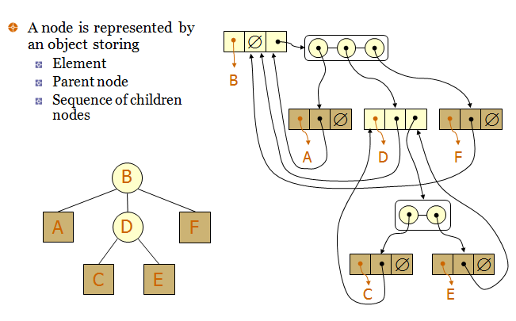
Tree representation

Slide 7
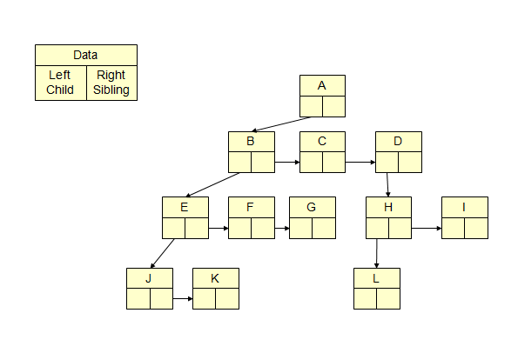
Left child, right child and siblings

Slide 8
Tree traversal
Two main methods:
  Preorder
  Postorder
Recursive definition
Preorder:
  visit the root
  traverse in preorder the children (subtrees)
Postorder
  traverse in postorder the children (subtrees)
  visit the root

Slide 9
Binary tree
A binary tree is a tree with the following properties:
  Each internal node has at most two children (degree of two)
  The children of a node are an ordered pair
We call the children of an internal node left child and right child
Alternative recursive definition: a binary tree is either
  a tree consisting of a single node, OR
  a tree whose root has an ordered pair of children, each of which is a binary tree

Slide 10
Examples of binary tree
Skewed Binary Tree
Complete Binary Tree
A
A
A
B
B
B
C
C
D
E
F
G
D
E
H
I

Slide 11
Full binary tree
A full binary tree of a given height k has 2^{k+1}–1 nodes.
Height 3 full binary tree.

Slide 12
Full binary tree (Contd..)
Label the nodes 1 through 2^{k+1} – 1.
Label by levels from top to bottom.
Within a level, label from left to right.
Parent of node i is node i / 2, unless i = 1.
Node 1 is the root and has no parent.

Slide 13
Complete binary tree
A labeled binary tree containing the labels 1 to n with root 1, branches leading to nodes labeled 2 and 3, branches from these leading to 4, 5 and 6, 7, respectively, and so on.
A binary tree with n nodes and level k is complete off its nodes correspond to the nodes numbered from 1 to n in the full binary tree of level k.

Slide 14

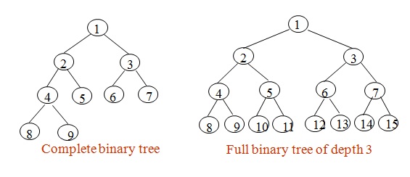
Binary Tree

Slide 15
Binary tree traversal
Let l, R, and r stand for moving left, visiting the node, and moving right.
There are six possible combinations of traversal lRr, lrR, Rlr, Rrl, rRl, rlR.
Adopt convention that we traverse left before right, only 3 traversals remain
  lRr, lrR, Rlr
  inorder, postorder, preorder

Slide 16
AVL Tree
AVL tree is a self-balancing Binary Search Tree (BST) where the difference between heights of left and right subtrees cannot be more than one for all nodes.
Why AVL Trees?
Most of the BST operations (e.g., search, max, min, insert, delete.. etc) take O(h) time where h is the height of the BST. The cost of these operations may become O(n) for a skewed Binary tree. If we make sure that height of the tree remains O(Logn) after every insertion and deletion, then we can guarantee an upper bound of O(Logn) for all these operations

Slide 17
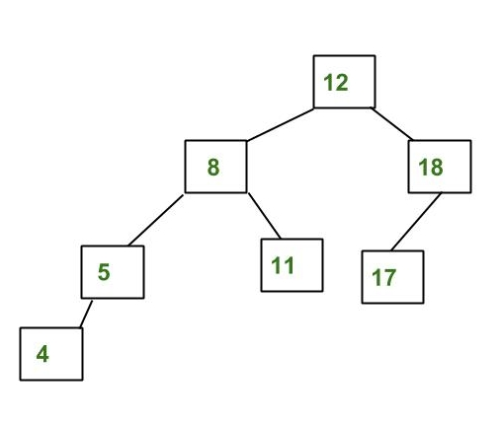
Example
The above tree is AVL because differences between heights of left and right subtrees for every node is less than or equal to 1.

Slide 18
B Tree
All leaves are at the same level.
A B-Tree is defined by the term minimum degree ‘t’. The value of t depends upon disk block size.
Every node except root must contain at least t-1 keys. The root may contain minimum 1 key.
All nodes (including root) may contain at most 2t – 1 keys.
Number of children of a node is equal to the number of keys in it plus 1.
All keys of a node are sorted in increasing order. The child between two keys k1 and k2 contains all keys in the range from k1 and k2.
B-Tree grows and shrinks from the root which is unlike Binary Search Tree. Binary Search Trees grow downward and also shrink from downward.

Slide 19
Red black tree
Red-Black Tree is a self-balancing Binary Search Tree (BST) where every node follows following rules:
1) Every node has a color either red or black.
2) Root of tree is always black.
3) There are no two adjacent red nodes (A red node cannot have a red parent or red child).
4) Every path from a node (including root) to any of its descendant NULL node has the same number of black nodes.

Slide 20
Why Red black tree?
Most of the BST operations (e.g., search, max, min, insert, delete.. etc) take O(h) time where h is the height of the BST. The cost of these operations may become O(n) for a skewed Binary tree. If we make sure that height of the tree remains O(Logn) after every insertion and deletion, then we can guarantee an upper bound of O(Logn) for all these operations. The height of a Red-Black tree is always O(Logn) where n is the number of nodes in the tree.

Slide 21
REFERENCES
Text books:
Cormen, Leiserson, Rivest, Stein, “Introduction to Algorithms”, Prentice Hall of India, 3rd edition 2012. problem, Graph coloring.
Horowitz, Sahni and Rajasekaran, “Fundamentals of ComputerAlgorithms”, University Press (India), 2nd edition
Websites:
https://www.tutorialride.com/data-structures/trees-in-data-structure.htm
https://www.geeksforgeeks.org/avl-tree-set-1-insertion/

Slide 22
Summary
Introduction to Trees
  Basic terms
  Types of Trees
  Binary tree
  B tree
  Balanced trees

Slide 23
THANK YOU

